Slide 1
Translating from an ER model to a Relational model
Notes:
Good place for early break?

Slide 2
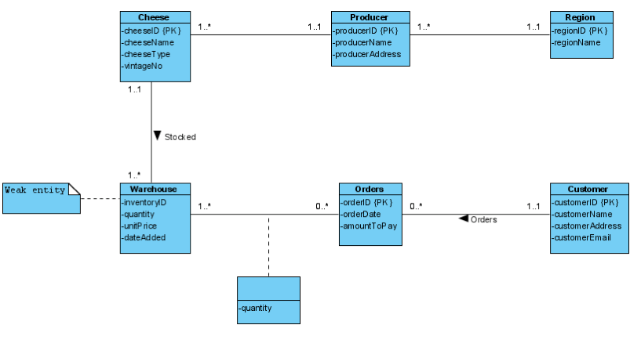
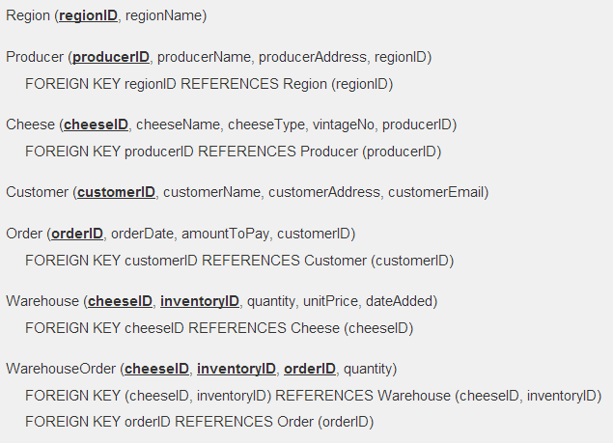
Logical Design – Map ER to RM

Slide 3
General Rules
Entities
an entity type becomes a relation with the same name
weak entity types – a relation with all simple attributes
primary key comes from the relation assigned to their defining relationship
Attributes
simple attributes are copied directly into the relation
primary key is copied directly into the relation
composite attributes are split into a separate single-valued attributes in the entity
e.g. name -> fName and lName

Slide 4
entity types strong
Strong Entity Types
for each strong entity, create relation with all simple attributes of that entity
for composite attributes, include only the constituent simple attributes
e.g. Staff (staffNo, fName, lName, position, sex, DOB)
Notes:
More specific rules for strong / weak entities
Leave MULTI-VALUE attributes until later!
(slide 41)

Slide 5
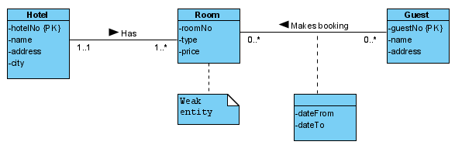
Hotel example - entities
>> extract strong entities
Notes:
NOTE : Room -> Guest is binary relationship, but CARDINALITY is not 1:* (it’s *:*)

Slide 6
entity types weak
Weak Entity Types
for each weak entity…
create a relation with all simple attributes of that entity
primary key of weak entity is partially or fully derived from (strong) owner entity …
so identification of primary key of weak entity cannot be made until all relationships with (strong) owner entity have been mapped
Example: Hotel/Room relationship is strong/weak
1:* relationship
Room – the weak entity; Hotel – the strong entity
Room (hotelNo, roomNo, ...)
Notes:
More specific rules for strong / weak entities
Leave MULTI-VALUE attributes until later!
(slide 41)

Slide 7
Hotel example - entities
>> extract weak entities
Notes:
NOTE : Room -> Guest is binary relationship, but CARDINALITY is not 1:* (it’s *:*)

Slide 8
Hotel example - entities
Relational DBMS:
Hotel (hotelNo, name, address, city)
Room (roomNo, hotelNo, type, price)
Guest (guestNo, name, address)
Notes:
NOTE : Room -> Guest is binary relationship, but CARDINALITY is not 1:* (it’s *:*)

Slide 9
1:*

Slide 10
relationships 1:* binary
For each 1:* binary relationship …
the entity on the ‘one side’ of the relationship is designated as parent
the entity on the ‘many side’ is designated as child
To represent this relationship …
post a copy of the primary key attribute(s) of parent entity into the relation representing the child entity, to act as a foreign key.
Example: Staff-Client relationship is 1-many (1:*)
Staff
Client
staffNo {PK}
name
fName
lName
position
sex
DOB
clientNo {PK}
name
fName
lName
telNo
1 .. 1
1 .. *
Notes:
Q: ASK – Can you remember what a binary relationship is?
END - If the relationship has attributes … store in CHILD

Slide 11
relationships 1:* binary
For each 1:* binary relationship …
the entity on the ‘one side’ of the relationship is designated as parent
the entity on the ‘many side’ is designated as child
To represent this relationship …
post a copy of the primary key attribute(s) of parent entity into the relation representing the child entity, to act as a foreign key.
Example: Staff-Client relationship is 1-many (1:*)
Staff (staffNo, fName, lName, position, sex, DOB) PARENT
Client (clientNo, fName, lName, telNo, staffNo) CHILD
staffNo is FK
FOREIGN KEY staffNo references Staff (staffNo)
Notes:
Q: ASK – Can you remember what a binary relationship is?
END - If the relationship has attributes … store in CHILD

Slide 12
relationships 1:* binary
Relationships with attributes …
all relationship attributes are posted to the child relation
(as attribute for relationship will have many values)
Notes:
Q: ASK – Can you remember what a binary relationship is?
END - If the relationship has attributes … store in CHILD

Slide 13
1:1

Slide 14
relationships: 1:1 binary (1/4)
participation constraints used to decide whether best to represent the relationship by …
combining the entities involved into one relation, or
creating two relations and posting copy of PK from one relation to other
Consider the following
mandatory participation on both sides of 1:1 relationship;
mandatory participation on one side of 1:1 relationship;
optional participation on both sides of 1:1 relationship
Notes:
PARTICIPATION is 1/0 at START of MULTIPLICITY ?..*
CARDINALITY is 1/* at END of MULTIPLICITY

Slide 15
relationships: 1:1 binary (2/4)
Case a) Mandatory-on-both-sides
Combine entities involved into one relation.
Choose one of PKs of original entities as PK of new relation.
Other PK (if one exists) is an alternate key.
Notes:
e.g. Client / Preference in C&B DreamHome.

Slide 16
relationships: 1:1 binary (3/4)
Case b) Mandatory-on-one-side
Entity type with optional participation in relationship designated as parent Entity type with mandatory participation designated as child
Create two relations
copy PK of parent entity into the relation representing the child entity
if relationship has one or more attributes, these should follow posting of primary key to child relation
Notes:
Case B – again, if relationship has entities, these are stored in CHILD.
Case C – but we always need two relations?

Slide 17
Example: Client states Preference
1 .. 1
States 
0 .. 1
Client
Preference
If a Client might state 0 or 1 preference (which means it is optional for a Client to state a preference)
- Client becomes parent (optional)
Preference becomes child
e.g.,
Client(clientNo, fName, lName )
Preference (prefNo, prefType, clientNo)
FK clientNo references Client(clientNo)
!! How about the alternative? : copy prefNo from Preference to Client

Slide 18
relationships: 1:1 binary (4/4)
Case c) Optional-on-both-sides
Create two relations
Use case b) approach (above)
Designation of the parent and child entities is arbitrary unless we can find out more about the relationship that can help a decision to be made

Slide 19
*:*

Slide 20
relationships: binary *:*
create a relation to represent the relationship
include any attributes that are part of the relationship
post copy of primary key attribute(s) of participating entities into the new relation, to act as foreign keys.
foreign keys are (composite) primary key of new relation
possibly in combination with attributes of the relationship
Example: Client Views PropertyForRent Viewing (clientNo, propertyNo, dateView, comment)
Client
PropertyForRent
clientNo {PK}
name
fName
lName
telNo
propertyNo {PK}
street
city
postcode
type
rooms
rent
0 .. *
views 
0 .. *
Notes:
Here a RELATION is generated out of relationship rather than entity.
*:* as any number of clients may view a property; a property may be viewed by any number of clients
May need attributes of relationship as PK too – see next slide

Slide 21
relationships: binary *:*
create a relation to represent the relationship
include any attributes that are part of the relationship
post copy of primary key attribute(s) of participating entities into the new relation, to act as foreign keys
foreign keys are (composite) primary key of new relation
possibly in combination with attributes of the relationship
Example: Client Views PropertyForRent Viewing (clientNo, propertyNo, dateView, comment)
Notes:
Here a RELATION is generated out of relationship rather than entity.
*:* as any number of clients may view a property; a property may be viewed by any number of clients
May need attributes of relationship as PK too – see next slide

Slide 22

example *:*
Two *:* binary relationships …
Actor (actorid, name, gender)
Movie (movieid, title, year)
Director (directorid, name)
ActsInMovie (movieid, actorid)
DirectsMovie (movieid, directorid)
Notes:
Movies2actors = ACTING: STARRED / ACTEDIN
Movies2directors = DIRECTION : DIRECTED / WASDIRECTEDBY

Slide 23
relationships: hotel example
Relational DBMS:
Hotel (hotelNo, name, address, city)
Room (roomNo, hotelNo, type, price)
Guest (guestNo, name, address)
Booking (hotelNo, guestNo, dateFrom, dateTo, roomNo)
Notes:
?Q: ASK – comment on PKs in booking – what does it allow / disallow?

Slide 24
relationships: hotel example
Relational DBMS:
Hotel (hotelNo, name, address, city)
Room (roomNo, hotelNo, type, price)
Guest (guestNo, name, address)
Booking (hotelNo, guestNo, dateFrom, dateTo, roomNo)
Notes:
?Q: ASK – comment on PKs in booking – what does it allow / disallow?

Slide 25

relationships: multiple e.g.
Teacher (teacher_id, name, address)
Student (student_id, name, email, supervisor_id, tutor_id) Foreign Key supervisor_id references Teacher(teacher_id) Foreign Key tutor_id references Teacher(teacher_id)
Notes:
Two separate relationships between entities.
Add appropriately re-named copy of PK as FK in child relation.

Slide 26
spec/gen

Slide 27
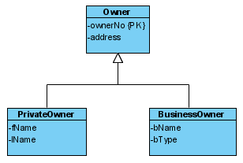
Superclass & subclasses
Many relations – one for superclass, one for each subclass …
Owner (ownerNo, address)
PrivateOwner (ownerNo, fName, lName) FOREIGN KEY ownerNo references Owner (ownerNo)
BusinessOwner (ownerNo, bName, bType) FOREIGN KEY ownerNo references Owner (ownerNo)
Notes:
Q: ASK – describe relationship as it might be specified in requirements / scenario.
Owner CAN have private owner or business owner (optional) but not both

